Slide 1
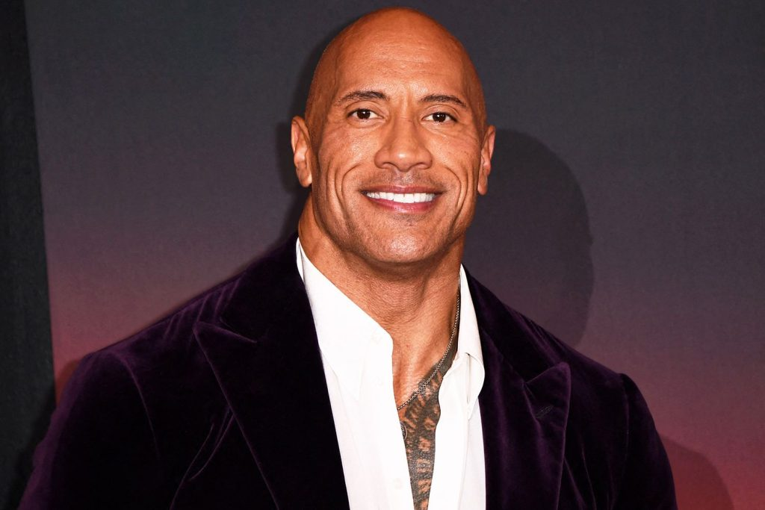



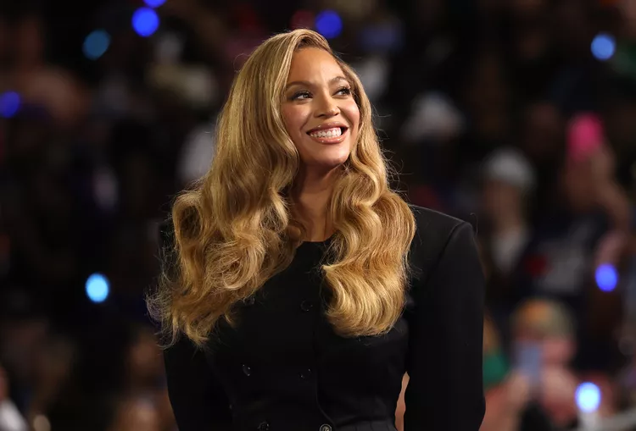
FAMOUS ENTERTAINERS ACROSS THE GLOBE
Presentation by Group 7

Slide 2


Introduction

Slide 3

TABLE OF CONTENT
PROJECT OBJECTIVE
PROBLEM STATEMENT
DASHBOARD OVERVIEW
FINDINGS
RECOMMENDATION
​

Slide 4

PROBLEM STATEMENT
Artists from Africa and the diaspora have both played major roles in shaping global music and film, yet those based in Africa often receive less global recognition.
This unequal visibility diminishes the acknowledged influence of African culture worldwide. This analysis aims to showcase their contributions and explore the differences in how they are recognized internationally.

Slide 5

Project objective
Click to add photo
1. To determine the most connected famous people.
2. To show the least successful people in the industry.
3. To know the regions where the famous peoples work are most successful.
4. To assess the award distribution across different categories.
To build a database and analyze famous individuals, revealing insights into their professional ties, achievements, and influence across both sectors.

Slide 6

INSIGHTS
Adele emerged as the most connected artist.
Omotola Jalade was the least successful among the most famous people.
A higher percentage of the awards went into the music industry.
2019 recorded the highest movie revenue.
2008 recorded the highest song revenue.

Slide 7
RECOMMENDATION
Africa should invest more into monetization system to increase the chances of revenue generation for artists
There should be talent development initiatives to professionally groom our current entertainers
​
n​
​
African entertainers should be encouraged to produce quality music and movies that can compete globally

Slide 8


Thank you

